Slide 1

Welcome to
Hamilton Python User Group for an
Introduction to Python
This slide show presentation will be posted on: https://github.com/HamPUG/meetings/tree/master/2016/2016-03-14

Slide 2
Introduction to Python
Hamilton Python User Group
14 March 2014
Presenters:
William Mckee
Lawrence D'Oliveiro
Ian Stewart
This slide show presentation will be posted on: https://github.com/HamPUG/meetings/tree/master/2016/2016-03-14

Slide 3
Introduction to Python
Agenda:
Welcome:
Introduction / Overview
Python in Action:
Python on a Raspberry Pi controlling GPIO ports.
Nikola Static Web-site Design.
Python: Installation, launching and getting help
Break / Chat / Questions.
Introduction to programming in python3:
Presentation performed using I-Python/Jupyter Notebook.
Drinks / Chat. Last one out, turn off the lights and lock the door.

Slide 4
Introduction to Python
Goals
  Observe python applications being used.
  Learn how to download and install python3 on your computer.
  Learn how to access/launch and get help on python3.
  Learn how to write python3 code.

Slide 5
Designed by: Guido Van Rossum from The Netherlands.
Development commenced December 1989.
First appearance: December 1991 (25 years ago)
Python 2 released October 2000 (V2.7 supported until 2020)
Python 3 released December 2008 (7 years ago)
Current stable: 3.5.1 ~ December 2015
Developed by: Python Software Foundation
Most common implementation is written in C. CPython.
Cpython generates intermediate byte code for a Virtual Machine.
Python websites: https://www.python.org/ https://www.python.org/psf/ wiki https://wiki.python.org/moin/
Python Enhancement Proposals (PEP's). Writing style see PEP#8 https://www.python.org/dev/peps/
Questions / Examples: http://stackoverflow.com/questions/tagged/python http://nullege.com/
Python Programming Language – Overview

Slide 6
Hamilton Python User Group - HamPUG
Commenced meeting in February 2014.
Meet every 2nd Monday of the month. (No meeting in January).
Room MS4.G.02 from 7pm to 9~10pm.
Main sponsor: Computer Science Dept. of Waikato University.
Repository: https://github.com/HamPUG
Meetup: http://www.meetup.com/nzpug-hamilton/
Forum/Mail: https://groups.google.com/forum/#!forum/nzpug
Meeting formats:
Topics that highlight a feature of Python
Demonstration of Applications written with Python
Show and Tell
Code reviewing / improvements
Chat / Share ideas
Informal meetings: Free admission, no membership, no committee.
Main Organiser / Host: Peter Reutemann – CS Dept. Waikato Uni.
Python in Hamilton

Slide 7
Python in NZ / Australia
Python User Group meetings in NZ:
Auckland, Hamilton, Wellington, Christchurch and Dunedin.
New Zealand Python User Group. NZPUG https://nzpug.org/
Incorporated Society Number 2250349 (2009)
Charity Registration Number CC52902 (2016)
NZPUG Membership: https://register.nzpug.org/join
Annual NZ Python Conference: Kiwi PyCon.
9-11 September 2016 in Dunedin.
Annual Australia Conference: PyCon Australia
12-16 August 2016 in Melbourne
PyCon presentations are normally video taped and up-loaded.

Slide 8
Level 5 – Use applications written in python.
User
Level 4 – Use python Applications as tools to develop applications.
Application Developer
Level 3 – Develop applications using Python
Programmer.
Level 2 – Develop python packages and wrapper modules.
Developer
Level 1 – Development of Python in C language
Developer / Designer / Transcriber / Technical Writer
Download source: https://www.python.org/downloads/
Python Enhancement Proposals (PEP's) https://www.python.org/dev/peps/
Bugs / bug fixing http://bugs.python.org/
Write Documentation
Python Levels of Interaction

Slide 9
Python Licensing...
Python is open source software:
Download source: https://www.python.org/downloads/source/
Distributed under a Python Software Foundation (PSF) licence: https://docs.python.org/3/license.html
PSF licence:
Since 2001complatible with General Public Licence (GPL).
Approved by Free Software Foundation (FSF).
Approved by Open Source Initiative (OSI).
Download python, install, no keys to type in, write code, distribute your code to anyone, others install python to run your code.

Slide 10
Why Python?...
Python has been a very popular programming language for a long time, used by many companies, scientists, casual and professional programmers (apps, cloud/web services, and web sites), and app scripters. Python has many good properties:
Reliable
Generally useful for scripting quick programs, app scripting, desktop apps, web servers, web services, scientific computing.
Easy to learn and has a good design to encourage good coding (many universities use it for introductory programming courses).
Supports a variety of styles of programming: imperative, functional, and object oriented.
Free open source and runs well on all major operating systems.
Many free, useful, and well-designed libraries.
Lots of documentation, samples, and help available on the internet
https://msdn.microsoft.com/en-us/library/dn705848.aspx

Slide 11
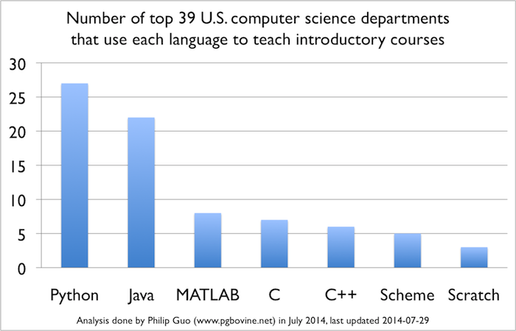
Python in University courses...
Python is Now the Most Popular Introductory Teaching Language at Top U.S. Universities. Link...
Waikato: Introduction to Computer Science for Engineers (2016)
Auckland: Principles of Programming: COMPSCI 101 Semester 1, 2016

Slide 12
Python in Action
Single Board Computer running python applications.
Website generation using Nikola

Slide 13
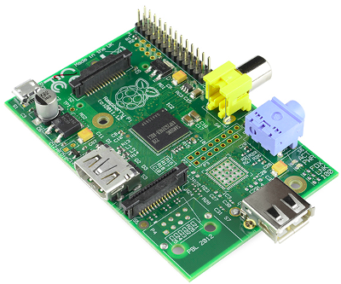
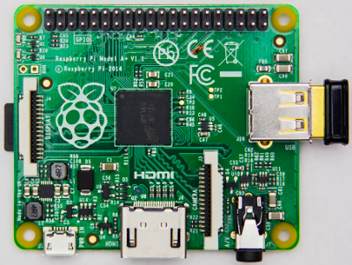
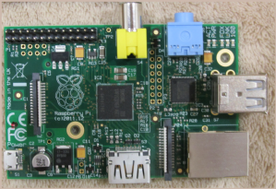
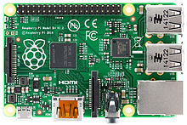
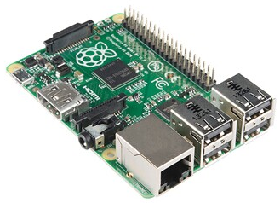
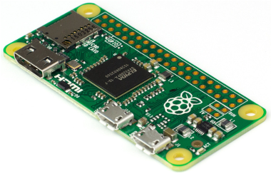
Single Board Computer - Raspberry Pi
Models of Raspberry Pi's (as of Dec 2015).
R-Pi 1 Model A
R-Pi 1 Model B
R-Pi 1 Model A+
BCM2835 – 700MHz 256-512MB
BCM2835 – 700MHz 256~512MB
BCM2835 – 700MHz 512MB
R-Pi 1 Model B+
R-Pi 2 Model B
R-Pi Zero
BCM2835 – 700MHz 512MB
BCM2836C – 900MHz 1GB
BCM2835 – 1GHz 512MB

Slide 14
Raspberry Pi - single board computer
Approximate costs...
Raspberry Pi $55
SDCard 8GB $10
5V Power Supply $10
HDMI cable to HDMI or to DVI $10
Mini-Bread board $15
Jumper lead set $5
Keyboard / Mouse / Monitor (re-cycled) $30
Total: $100 ~ $150

Slide 15
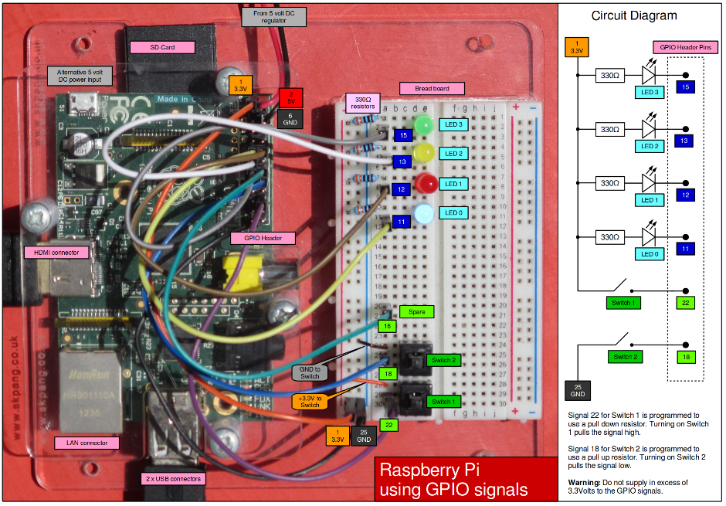
Raspberry Pi – Model B with Breadboard

Slide 16

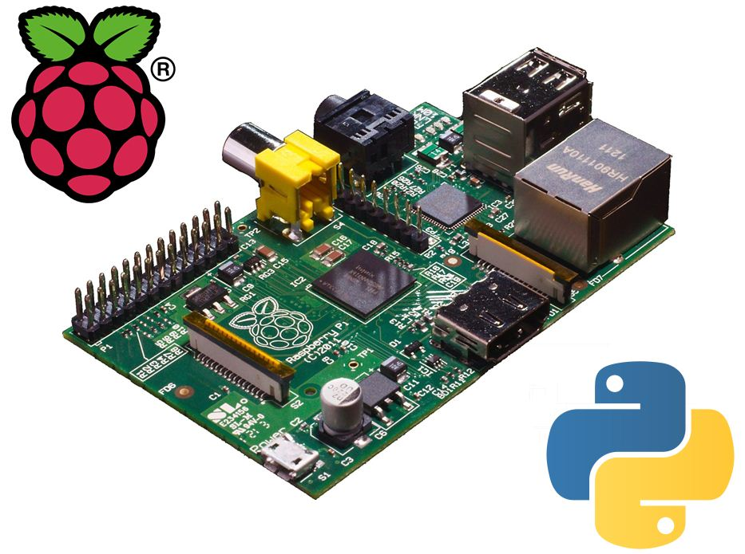
Presentation on Raspberry Pi / Raspbian / Python / Tkinter / RPi.GPIO...

Slide 17
Presentation by Ian
The python programs used in this presentation meeting. They are in the github/HamPUG website:
https://github.com/HamPUG/meetings/tree/master/2016/2016-03-14
The files are...
06_demo_ttk_4_led_counter_inc_dec.py
09_demo_ttk_pwd_exponential.py

Slide 18
Raspberry Pi / Python / Tkinter / Rpi.GPIO
Demonstration python code
https://github.com/HamPUG/meetings/tree/master/2015/2015-12-14
Raspberry Pi
https://www.raspberrypi.org/
Download Raspbian
https://www.raspberrypi.org/downloads/
Installation guide
https://www.raspberrypi.org/documentation/installation/installing-images/README.md
Raspbian
https://www.raspbian.org/

Slide 19

Presentation on...
Nikola — Static Site Generator
written in Python

Slide 20
Presentation by William
This presentation is at the web-site
https://github.com/HamPUG/meetings/tree/master/2016/2016-03-14
The filename is: nikola-march.svg
The file is best viewed with a web-browser.

Slide 21
Links...
Website:
https://getnikola.com/
Python Package Index
https://pypi.python.org/pypi/Nikola/
Installation
$ sudo pip install --upgrade "Nikola[extras]"
$ sudo apt-get install nikola
Example web-sites:
http://www.acml-conf.org/2016/
http://artctrl.me

Slide 22
Installing Python3...
If it's not already installed, then free to download and install...
Windows – Download and install x86-64 or x86 from...
            https://www.python.org/downloads/windows/
  Also see the faq for Windows...
            https://docs.python.org/3/faq/windows.html
Linux distro's normally include python3. If it's missing then…
  $ sudo apt-get install python3
Apple Mac OS X include python2.
May need to install python3. Download and install from…
https://www.python.org/downloads/mac-osx/
Source code...
            https://www.python.org/downloads/source/

Slide 23
Additional Windows installation information – Provided by Chris O’Halloran...
If you're interested in getting python working on Windows system then you can use the Anaconda distribution from continuum.
https://docs.continuum.io/anaconda/install
https://www.continuum.io/downloads
If you are new to Python, start with Python3.5. Pretty much all the active third party libraries have migrated now.
With Ananconda installed, you'll even get a GUI menu option to start your ipython3 notebook and away you go!.
Anaconda has done all the hard work of compiling a large variety of third party libraries - which is one of the huge attractions of Python.

Slide 24
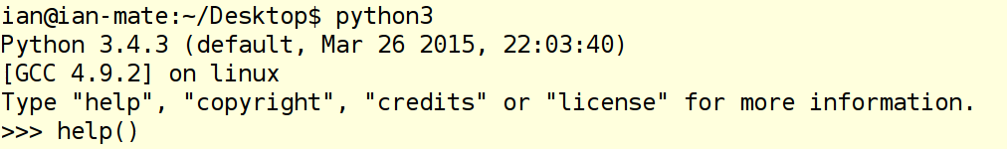
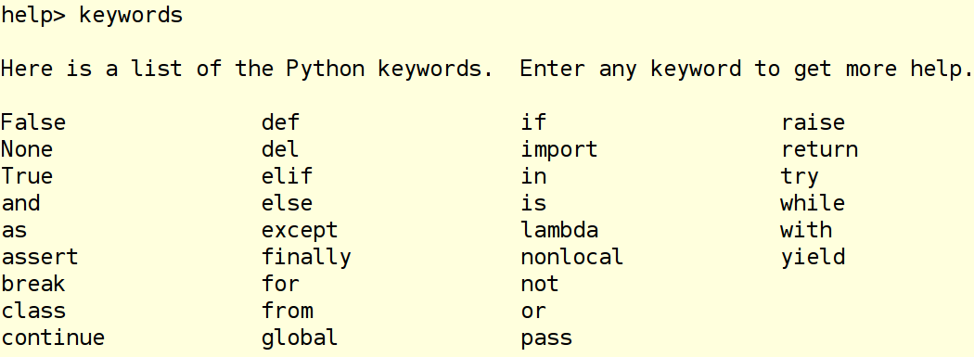
Python3 interactive mode. help()...
Open terminal window. Launch Python3 in interactive mode…
Type help()
Get help on the keywords used in a python program...

Slide 25
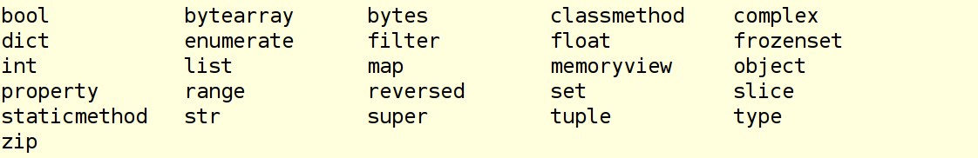
dir() for builtin class and functions...
Type dir()
The module __builtins__ contains the classes and functions builtin to python. To list these modules type dir(__builtins__)
About 150 items are listed. Significant Class builtins...

Slide 26
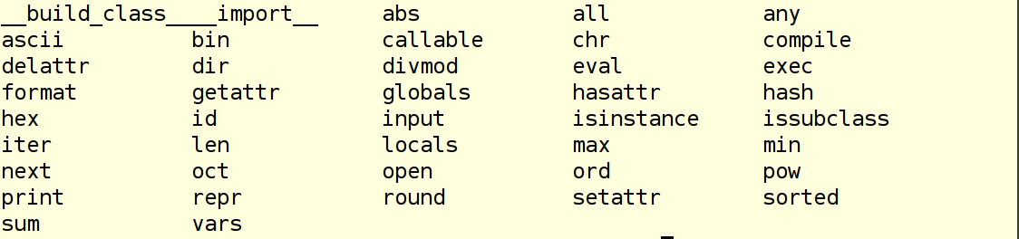
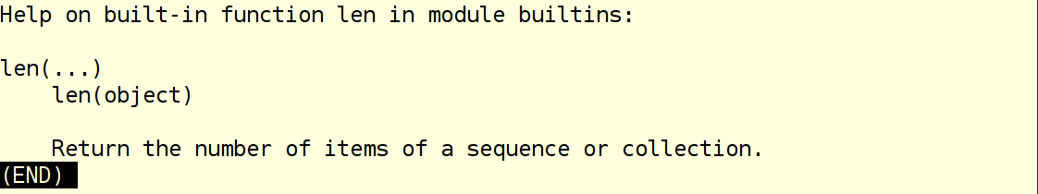
dir() for builtin class and functions...
About 150 items are listed. Significant Function builtins...
Get help on any of these classes or functions...
Type q (for quit) to exit help on an item

Slide 27
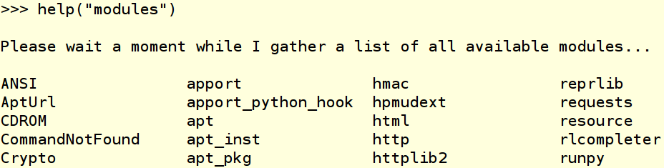
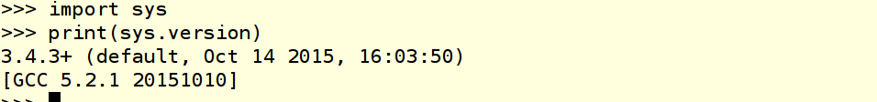
Modules distributed with python3...
About 400 modules are included with python3 ...
Import a module. Use the module and one of its functions...
For more information on the module use help() and dir()
E.g. help(“sys”) and dir(sys)

Slide 28
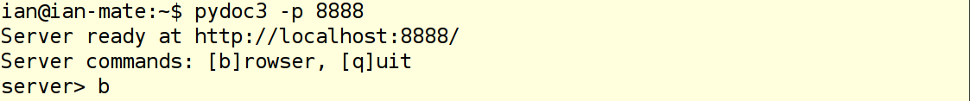
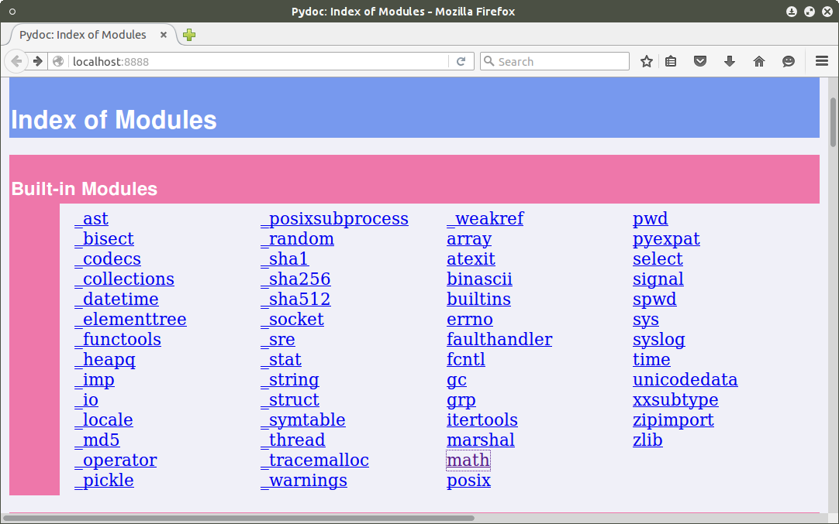
pydoc3 browser...

Slide 29
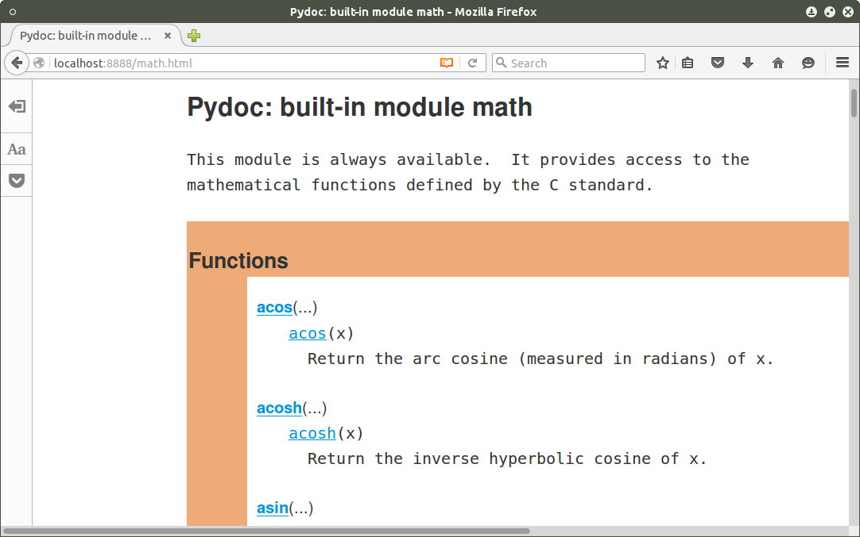
pydoc3 browser...
Math module...

Slide 30
PyPI - Python Package Index...
Website...
      https://pypi.python.org/pypi
The Python Package Index is a repository of software for the Python programming language. There are currently 76343 packages here. (2016-Mar-12 23:00)
Get Packages
To use a package from this index either "pip install package" (get pip) or download, unpack and "python setup.py install" it.
Packages include Nikola and Jupyter/IPython...
Nikola V7.7.7: 397 downloads in the last day.
IPython V4.1.0: 21670 downloads in the last day.

Slide 31
Writing python code the non-IDE way...
Requirements:
Text Editor to write the python script. With line numbering, tabs set to 4 space characters, colour highlighting of code.
Console terminal to launch the python script in the text file.
Console terminal running interactive python to develop and test code snippets.
Web browser for python references, help and examples.

Slide 32
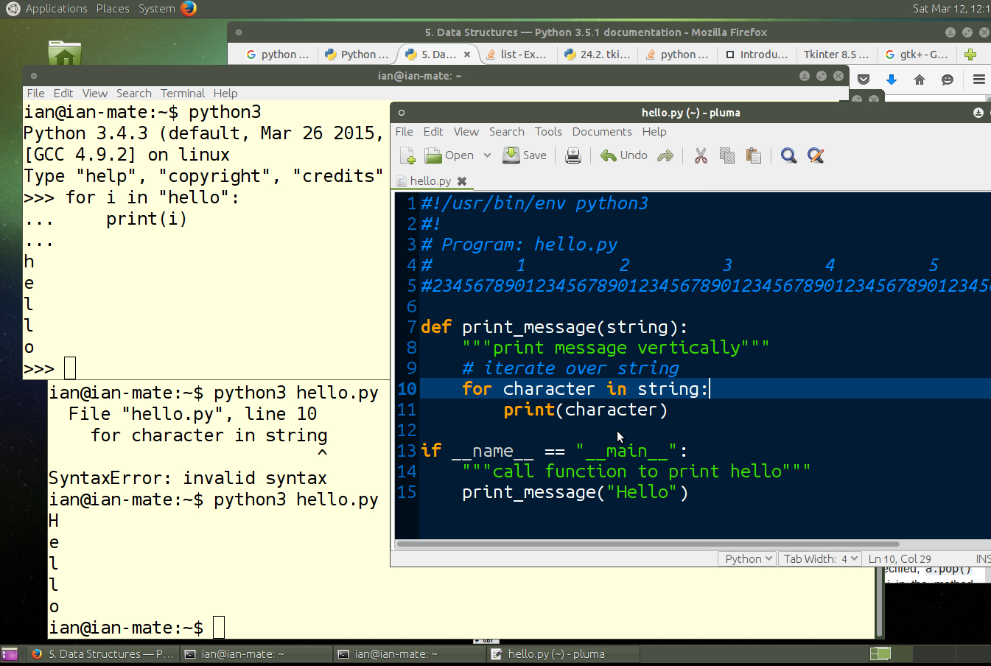
Writing python code the non-IDE way...

Slide 33


Introduction to writing Python using...
IPython in the Jupyter Notebook
As of IPython 4.0, the language-agnostic parts of the project: the notebook format, message protocol, qtconsole, notebook web application, etc. have moved to new projects under the name Jupyter. IPython itself is focused on interactive Python, part of which is providing a Python kernel for Jupyter.

Slide 34
Presentation by Lawrence
The presentation is located at…
https://github.com/HamPUG/meetings/tree/master/2016/2016-03-14/ldo
The filename is:
Python Intro Talk.ipynb
Install Jupyter/IPython to use this file.

Slide 35
Links...
Website
http://ipython.org/
Jupyter Installation Guide
http://jupyter.readthedocs.org/en/latest/install.html

Slide 36
Next month's
Hamilton Python User Group meetup
7pm Monday 11 April 2016
Any request for topics?
Anyone got some code to show and tell about?
Any module/application you want to demo?
Etc...
Chat to us about what you'd like or what you have to demo.
Post ideas on meetup.com

Slide 37
__the_end__.py
…just one last demo?…
It will only take a minute...

Slide 38
Python-UNO Bridge - Demonstration
Python script creates a blank LibreOffice Impress slide show.
Setup blank slide size.
Access LibreOffice API to create rectangles and circles, etc
Python interpreter with import uno
LibreOffice
soffice.bin
Port 2002 open for connection.
Py-UNO Bridge
LibreOffice Impress
Slide Show
Display Rectangles, Circles, Text, etc.
pythonhouse.py
python script
with data

Slide 39
The python-UNO bridge demonstration is located in: https://github.com/HamPUG/meetings/tree/master/2016/2016-03-14
The filename is: pythonhouse-2016-03-14.py

